Slide 1


Leveraging Cloud AI for innovation

Slide 2

1 AWS Bedrock:Foundation Models and Generative AI Capabilities

Slide 3



Exploring Amazon Bedrock's core services and model access
Normal Model Access Procedures
Familiarize yourself with the standard procedures for accessing and integrating foundation models within the Amazon Bedrock environment.
Understanding Bedrock's Foundation Models
This section delves into the various foundation models available through Amazon Bedrock, detailing their capabilities and optimal use cases for AI development.

Slide 4




Implementing generative AI solutions with Bedrock's API
Leveraging Bedrock API for Innovation
Integrating Generative AI via API
The Bedrock API is instrumental for AI teams to integrate generative AI capabilities into their applications, driving innovative solutions.
Developing AI Solutions with Bedrock
This segment focuses on the practical steps and best practices for integrating generative AI functionalities into existing systems using Bedrock's API.
Normal API Implementation Steps
Explore methodologies for developing robust and scalable generative AI solutions by effectively utilizing the Amazon Bedrock API for various applications.
Understand the typical steps involved in implementing generative AI solutions through the Amazon Bedrock API, ensuring smooth integration.

Slide 5
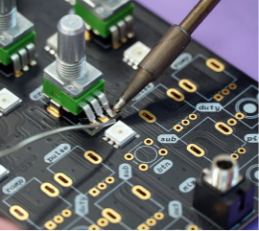
Securing and managing AI applications on AWS Bedrock
Securing AI Innovation on AWS
Ensuring the security of AI applications on AWS Bedrock is paramount for teams innovating with generative AI, protecting data and models.

Slide 6

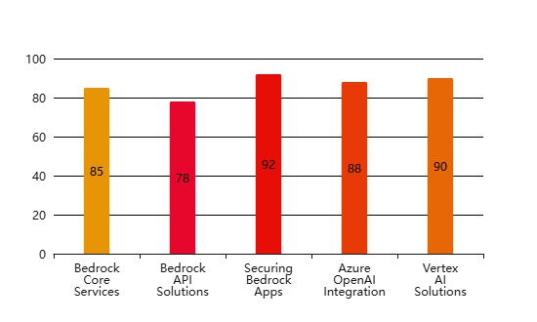
Cloud AI Services Adoption and Implementation
Effectiveness of Cloud AI Service Implementation(Effectiveness Score (%))

Slide 7
2 Azure OpenAI:Integrating Advanced AI Models into Applications

Slide 8




Leveraging Azure OpenAI Service for enterprise AI solutions
Azure OpenAI for innovation
Cloud AI for business innovation
Integrating advanced AI models
Enterprise AI solution strategies
Learn how Azure OpenAI empowers AI teams to innovate by providing access to powerful language models and tools for diverse business needs.
Explore how AI teams can leverage Azure OpenAI Service to drive innovation and create impactful enterprise AI solutions, focusing on practical applications.
Understand the process of integrating advanced AI models from Azure OpenAI into existing applications, enhancing capabilities and user experiences.
Discover strategic approaches for implementing enterprise-grade AI solutions using Azure OpenAI, ensuring scalability, security, and performance.

Slide 9



Deploying and fine-tuning large language models on Azure
Azure for LLM deployment
Examine the robust infrastructure Azure provides for deploying and managing large language models, ensuring reliability and high availability for AI applications.
Fine-tuning models for specific needs
Master the techniques for fine-tuning large language models on Azure to meet specific business requirements and enhance model accuracy and relevance.
Optimizing LLM performance
Learn best practices for optimizing the performance of large language models deployed on Azure, ensuring efficient resource utilization and responsiveness.

Slide 10

Ensuring responsible AI practices with Azure OpenAI tools
Responsible AI with Azure OpenAI
Understand the critical importance of responsible AI practices when utilizing Azure OpenAI tools, ensuring ethical and fair AI system development.
Building trustworthy AI systems
Focus on strategies for building trustworthy and transparent AI systems using Azure OpenAI, fostering user confidence and mitigating potential risks.
Azure tools for responsible AI
Discover the various tools and features within Azure OpenAI that support responsible AI development, including content moderation and fairness assessments.

Slide 11

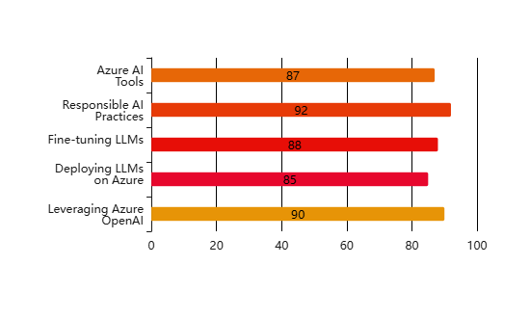
Enterprise AI Solutions with Azure OpenAI
Key Aspects of Azure OpenAI Service Adoption(Effectiveness Score (%))

Slide 12
Thank You

